Slide 1
HelpFinder
By: Mohmmadazhar, Abhi, Tahir

Slide 2
Elevator Pitch
We believe that the HelpFinder app will be crucial to anyone and everyone who is looking to save money or someone who is looking to do a side business and make some money. There will be two sides to the app, Buyer and Seller. Seller can promote their services based on their skills and buyer can find services that they are looking for. Buyers can also look at sellers reviews and decide if they want to hire them for a job. As of right now we have decided to do services such as Plumber, Mechanic and Electrician

Slide 3
The problem? Why is it important?
We feel like there are so many people who has skills that they can use as a side business and make some extra money
We also feel like there are many customers who are looking to get a specific minor job done but they don’t want to hire professional who are very expensive.

Slide 4
Who stands to benefit from this app most?
We believe it benefits both parties because the seller is making extra cash on their own time and the customer is getting their desired job done for a reasonable amount of money

Slide 5
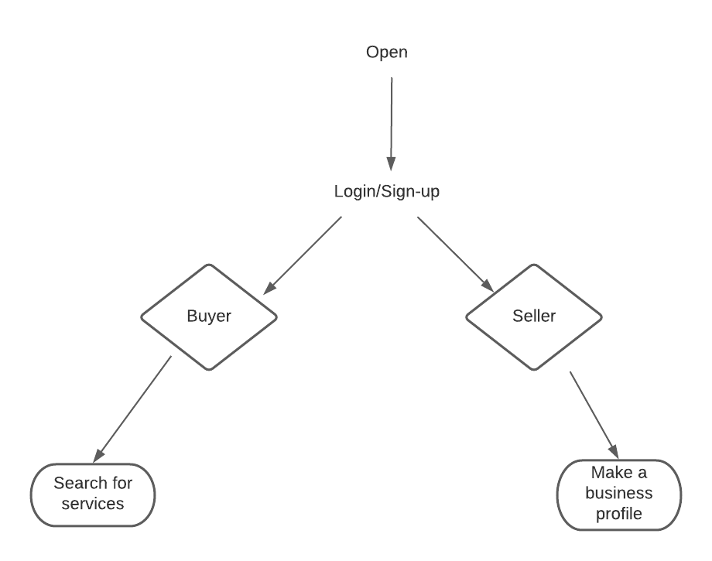

Slide 6
Email
Password
Login
Signup

Slide 7
BUYER
SELLER

Slide 8
Search for services
Buyers Page

Slide 9

Sellers Profile
SELLER NAME
SERVICES OFFERED
Plumbing
Mechanic
Electrician
SELLER REVIEWS
SEND A MESSAGE

